Slide 1
Serenity Choice Christmas Gift Idea

Slide 2
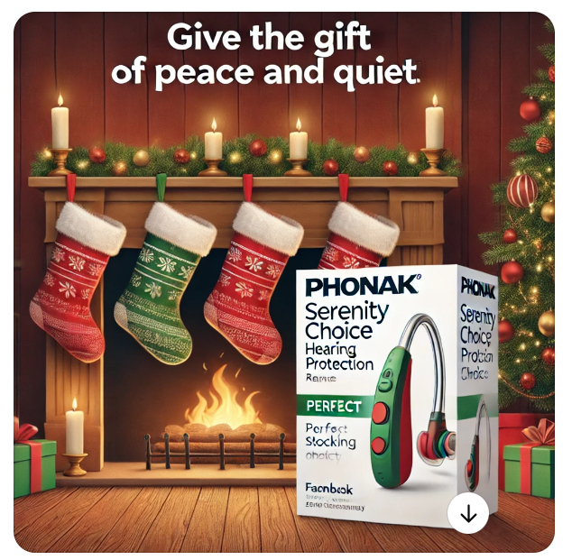
Overall Serenity Choice
Link
Facebook BtBtC | Is there such a thing as the perfect stocking stuffer? 🎁 Absolutely! This holiday season, give the gift of peace and quiet with Serenity Choice™ hearing protection. Designed to reduce noise and loud sounds, it’s the ideal present for everyone on your gift list!
Instagram reel | Puzzled as to what to give friends and family this holiday season? 🎁 Give the gift of peace and quiet with Serenity Choice™ hearing protection! Designed to reduce noise and loud sounds, it’s the ideal present for: Mum Dad Aunt Sally Grandpa Joe Everyone!
CTA | Contact your hearing care professional for more information
MAM link:
Asset:

Slide 3
Music Serenity Choice
Link
Facebook BtBtC | Looking for the perfect gift for your favourite drummer, guitarist or singer? 🎁 Search no further! Give the gift of Serenity Choice™ Music hearing protection for the music lover in your life. 🎶✨ The patented filter technology reduces sound to a safe level, making it great for music listening as the listener doesn't lose any of the original sound.
Instagram reel | Looking for the perfect gift for your favourite 🥁 Drummer 🎸 Guitarist 🎤 Singer 🎶 Concert goer Treat the music lover in your life to Serenity Choice™ Music hearing protection. The patented filter technology reduces sound to a safe level, making it great for music listening as the listener doesn't lose any of the original sound.
CTA | Call your clinic today to learn more.
MAM link:
Asset: The gift of hearing protection … for the music lover!

Slide 4
Motosport Serenity Choice
Asset: The gift of hearing protection … for the thrill seeker!
Link
Facebook BtBtC | What will thrill your favourite thrill seeker this holiday season? 🎁 The gift of hearing protection! Serenity Choice™ Motorsport hearing protection reduces helmet-generated noise to safe levels yet still allows speech to be heard from intercom speakers. 🏍️✨
Instagram reel | What is one gift every thrill seeker needs this holiday season? 🏍️✨ The gift of hearing protection! 🎁 Serenity Choice™ Motorsport hearing protection reduces helmet-generated noise to safe levels yet still allows speech to be heard from intercom speakers.
CTA | Call your clinic today to learn more.
MAM link:

Slide 5
Work Serenity Choice
Asset: The gift of hearing protection … for the heavy-duty worker!
Link
Facebook BtBtC | Stumped as to what to give someone who works in construction, farming or machine shops for the holidays? Give the gift of hearing protection! Serenity Choice™ Work hearing protection reduces noise from heavy equipment, machinery and power tools and is designed as personal protection equipment for noisy working environments.
Instagram reel | What’s the best gift to give someone who works in 🚧 Construction 🚜 Farming 🔧 Machine shops The gift of hearing protection! Serenity Choice™ Work hearing protection reduces noise from heavy equipment, machinery and power tools and is designed as personal protection equipment for noisy working environments.
CTA | Ask your hearing care provider for more information.
MAM link:

Slide 6
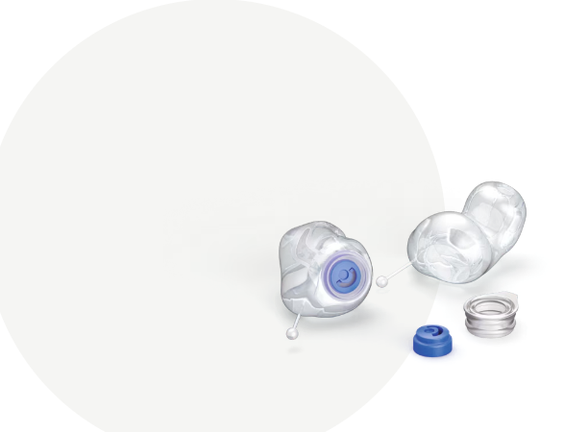
Plus Fly Serenity Choice
Asset: The gift of hearing protection … custom-made earplugs for the high flyer
Link
Facebook BtBtC | ✈️🎁 Looking for the perfect gift for the frequent traveller in your life? Add Serenity Choice™ Plus Fly to their stockings! These custom-made earplugs reduce background noise on flights, making every journey more peaceful and enjoyable.
Instagram reel | Got a frequent traveller on your gift-giving list? ✈️🎁 Wrap up a pair of Serenity Choice™ Plus Fly! These custom-made earplugs reduce background noise on flights, making every journey more peaceful and enjoyable.
CTA | Contact your hearing care professional to learn more.
MAM link:

Slide 7
Custom Swim Serenity Choice
Asset: The gift of hearing protection … custom-made earplugs for the water splasher
Link
Facebook BtBtC | Looking for a gift that is sure to make a splash with the water lover in your life? 🎁🌊 Try Serenity Choice™ Plus Swim! These custom-made earplugs are designed to prevent water from entering the ear while providing full situational awareness.
Instagram reel | Who would want a pair of Serenity Choice™ Plus Swim this holiday season? They’re perfect for your water lovers who 🏊‍♂️ Swim 🏄‍♀️ Surf 🤸‍♀️ Do water aerobics These custom-made earplugs are designed to prevent water from entering the ear while providing full situational awareness.
CTA | Ask your hearing care provider for more information.
MAM link:

Slide 8
Sleep Serenity Choice
Asset: For the heavy sleeper – Serenity Choice Plus Sleep
Link
Facebook BtBtC | Give the gift of a good night’s rest. 🌙💤 Add Serenity Choice™ Sleep to their stockings this holiday season. Designed for a deeper rest, these ear plugs reduce the noise you might expect from a snoring, street noise and more.
Instagram reel | What’s the one gift everyone could use this holiday season? A good night’s rest, thanks to Serenity Choice™ Sleep! 🌙💤 Designed for a deeper rest, these ear plugs reduce the noise you might expect from a snoring, street noise and more.
CTA | Contact your clinic for more information.
MAM link:

